Slide 1
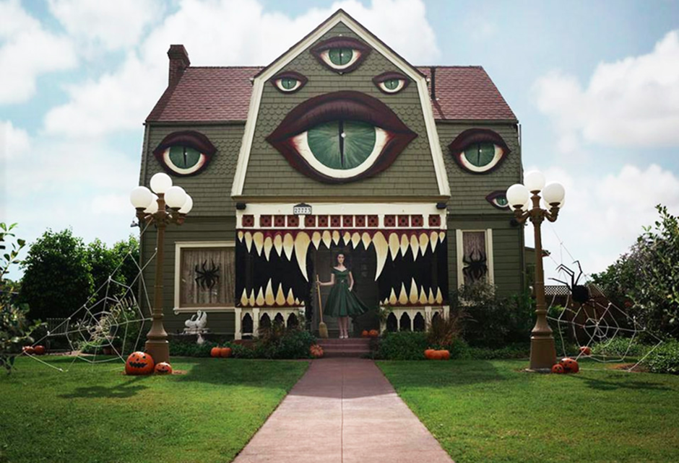
The Haunted House

Slide 2

Can you think of a title for the story?
___________________________________________________________

Slide 3
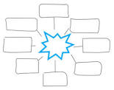

Question time!
Where do you think the house is?
Who lives there?
What will happen to the children if they approach the house?

Slide 4
Perfect picture!
What do you think the house looks like on the inside? Choose any room in the house and draw what you would expect to find there.

Slide 5
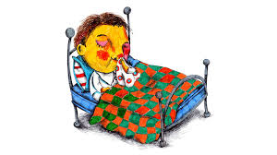
Sick sentences!
These sentences are 'sick' and need your help to get better!
The house was spooky. The roof had eyes.

Slide 6
Sentence challenge!
What is the impact of using short sentences in the story starter?
Can you continue the story using these sentence openers?
Think about the length of your sentences and how this can convey information to your reader.
The ground felt…
The house cast a shadow…
Suddenly it was clear…

